Slide 1


Amazon Business Intelligence Report
By Datta Hadawale

Slide 2
Objective
Amazon business intelligent report want to create annual sales & product report in 2023 & 24 .
This report can help me to understand the e-commerce sales & learn the new things
The objective of this report is to analyze amazon sales data to understand overall business performance and support better decision-making.

Slide 3
Questions
What is the total revenue ?
What is the total orders count ?
What is the average order value (AOV) ?
Which product category generates highest revenue ?
Which region generate highest sales ?
Monthly sales trend ?
Top 10 selling products ?
Revenue by product method ?
Impact of discount on sales ?
Which month had highest revenue ?

Slide 4
Dataset

Slide 5
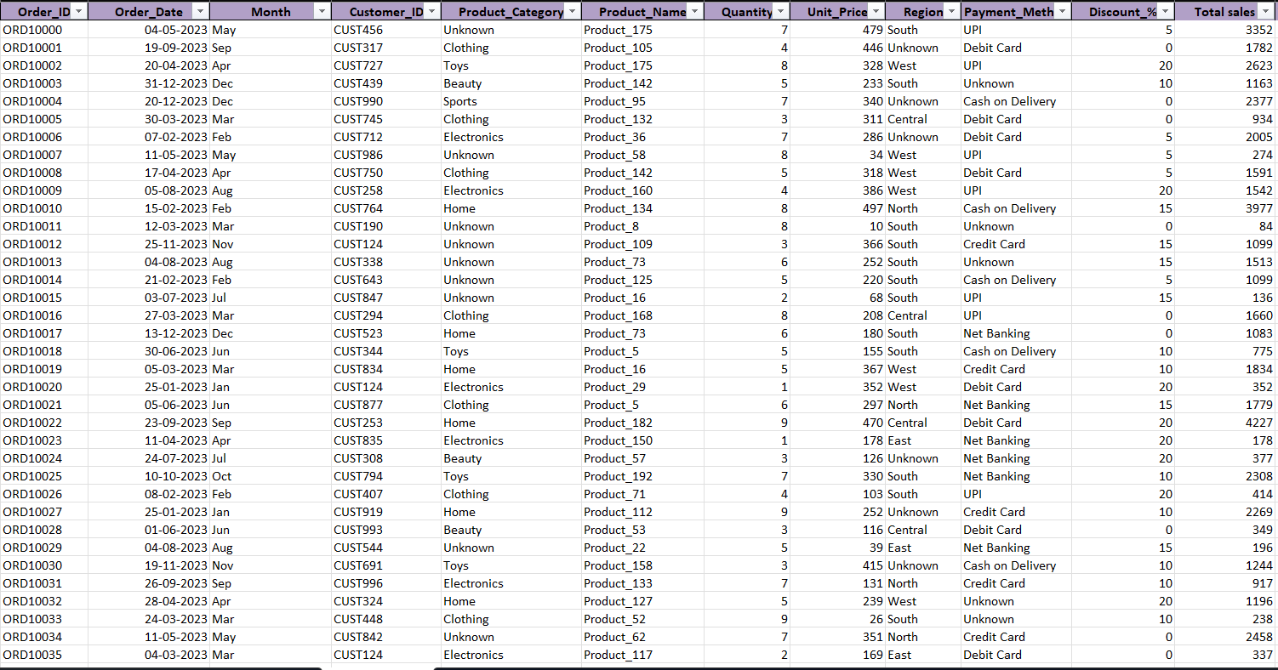

Slide 6
Charts

Slide 7
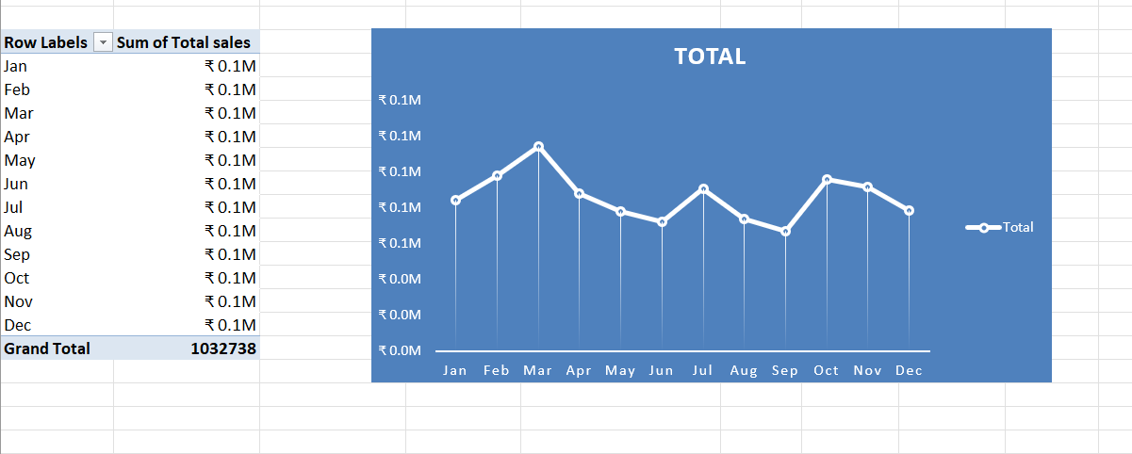
Monthly sales (in m)

Slide 8
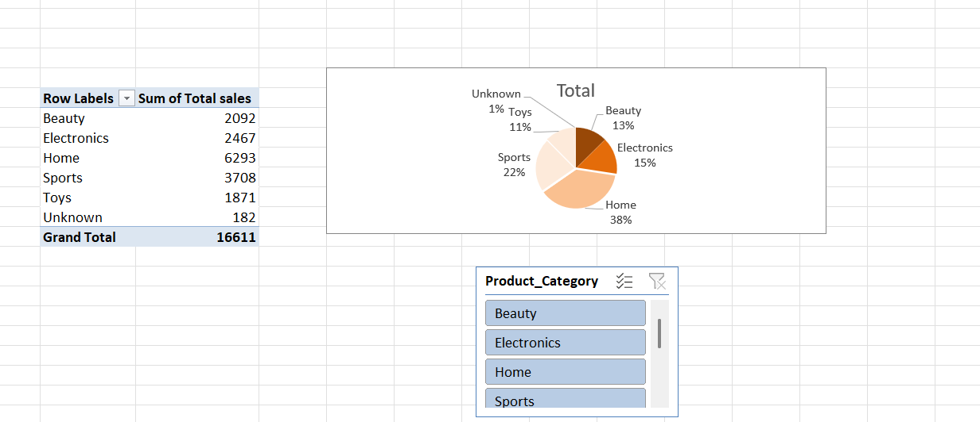
Sales by categories

Slide 9
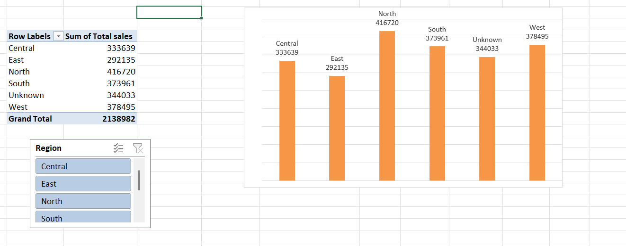
Sales by region

Slide 10
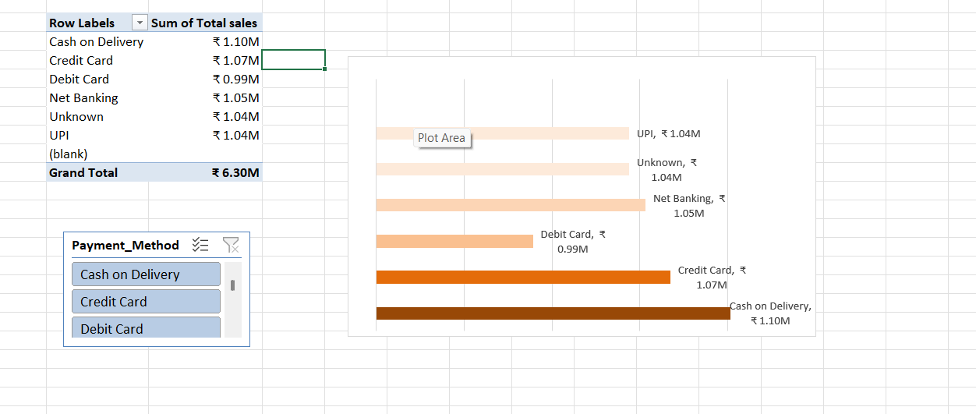
Payment analysis by sales

Slide 11
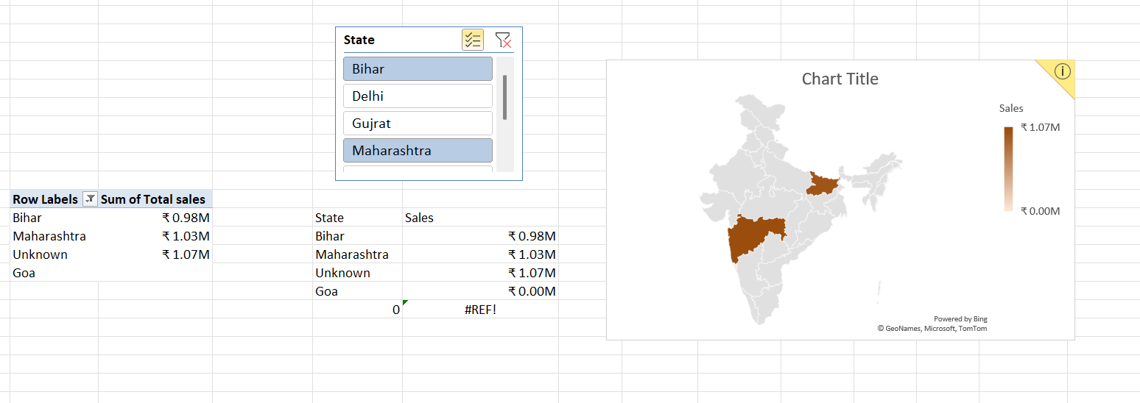
Sales by state

Slide 12
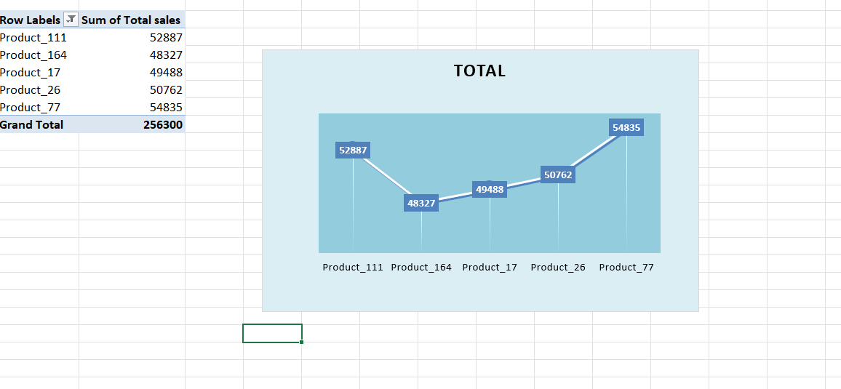
Top five product by sales

Slide 13
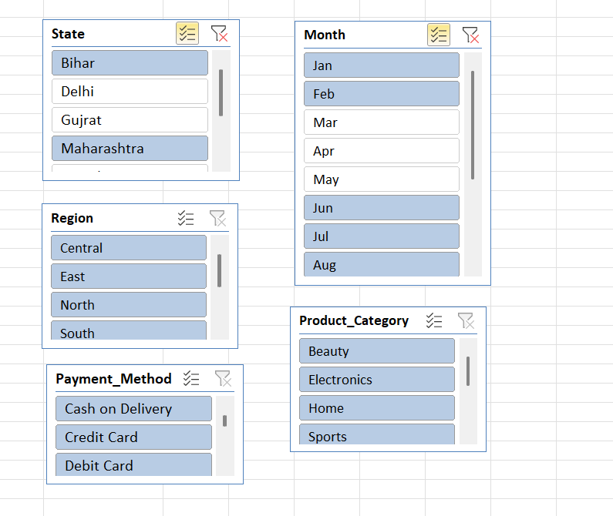
Slicer

Slide 14
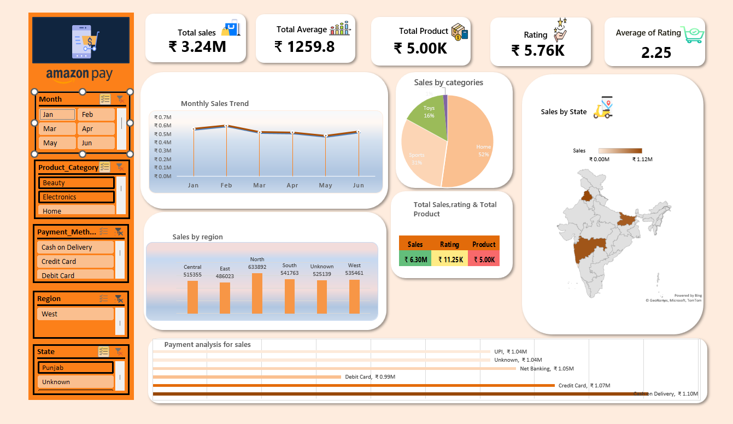
Final dashboard

Slide 15
Insights
I analyzed the amazon sales report for 2023 and identified important insights related to sales performance, categories, regions, and payment methods.
January, february, and august have the highest sales of 0.6m. These months performed better compared to other months.
The category analysis shows me that the home category generated the highest sales, followed by sports as the second-highest performing category. Electronics ranked third in overall sales performance.

Slide 16
The payment method analysis shows me that cash on delivery is the most preferred payment method, generating sales of 1.10m. Credit card is the second most used payment method, contributing 1.07M in total sales.

Slide 17
Conclusion
From the amazon sales report 2024, we found that january, february, and august had the highest sales.
The home category performed best, and cash on delivery was the most used payment method.
The north region had the highest sales, and product_111 was the top-selling product. This report helps in understanding business performance and improving decisions.

Slide 18
Thank You…

